Slide 1
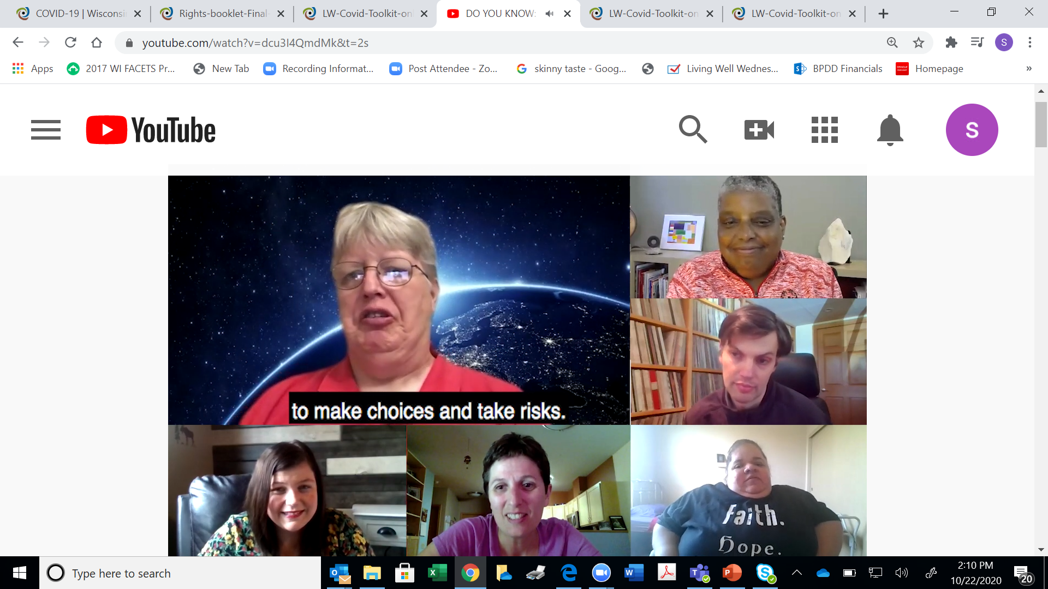
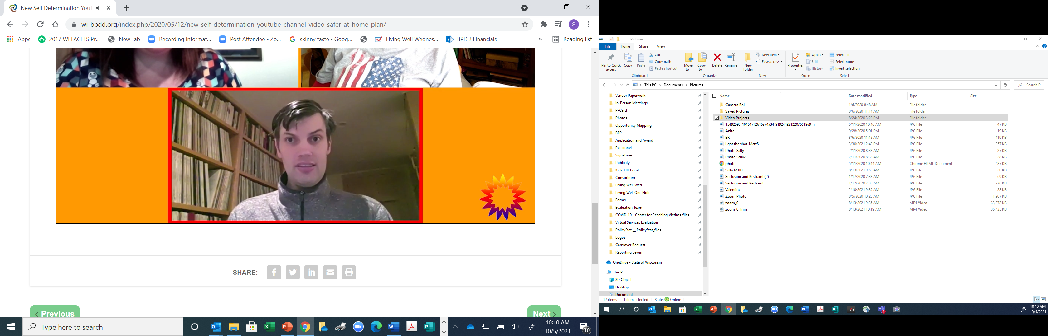
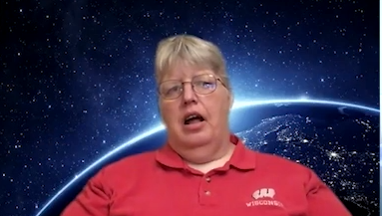
Notes:
Sally

Slide 2

Living Well Grant
A five-year grant to help improve the independence, integration, safety, health and wellbeing of people with disabilities.
We are working with 8 service providers and 10 self-advocate leaders in the State to help us education people with disabilities and their families.
Three educational tools: Healthy, Safe and Connected Toolkit, Safe and Free, and Let’s Talk about Right Guides
Notes:
Sally

Slide 3
National Core Indicators- People Driven Data
Wisconsin participates in the National Core Indicators for People with Intellectual and Developmental Disabilities (ID/D) https://idd.nationalcoreindicators.org/
The primary goal of this data collection is to measure the public systems that support people with ID/D.
The questions focus on the experiences of people with disabilities in multiple quality of life domains.
40% report rules about having friends or visitors
40% want a cell phone or smartphone
Wisconsin Core Indicators Report: WI IPS 20-21 State Report 508.docx (nationalcoreindicators.org)
Notes:
Sally

Slide 4
National Core Indicators-People Driven Data
National and Wisconsin Results that may contribute to Social Isolation and Loneliness:
Wisconsin Data
19% paid job in the community
53% do not have a paid job but wants one
26% are volunteers of some type
39% went out for entertainment in the past month
55% went to a restaurant or a coffee shop in the past month
22% went out to a religious service in the past month
28% participate in a community group
64% able to go out and do that they like in the community
67% can see friends when they want
39% want more friends
11% often feel lonely
44% want to be a part of more community groups
40% report rules about having friends or visitors
40% want a cell phone or smartphone
Notes:
sally

Slide 5
National Core Indicators-Predictors of Abuse/Neglect
The National Core Indicators list these as the main predictors of abuse and neglect:
  Social isolation (lack of friendships and relationships beyond paid staff)
  Social stigma related to a lack of respect for people with disabilities
  Lack of privacy within the residence
  Ignorance of individual rights
  Staff stress and lack of training
  Significant dependence on others
  Lack of control/decision-making
  Lack of community participation
Notes:
Sally

Slide 6
Council on Quality and Leadership(CQL)
CQL works to improve the quality of life for people with intellectual, developmental and psychiatric disabilities.
CQL works with human service providers, national organizations, and governmental agencies around the work to improve quality.
They focus on person-centered quality implementation through their training and data measures.
The Living Well grant has partnered with them to gather data on the quality of life of over 155 individuals in Wisconsin.
CQL has also trained provider agencies on their basic assurances, quality frameworks, and human rights committee.
Notes:
Sally

Slide 7
Council on Quality and Leadership: Social Capital for People with Disabilities
People’s relationships and social networks are an important aspect of a person’s health and quality of life. Their social capitol.
Social capital has been shown to improve people’s physical and mental health outcomes.
Social capital can improve access to resources, resilience, and mutual aid.
CQL uses their Personal Outcomes Measures interview to measure human security, relationships, community, choices, and goals.
Notes:
Sally

Slide 8
Council on Quality and Leadership: Social Capital for People with Disabilities
People with disabilities only had 38.8% of social capitol index present.
The following areas were lacking:
    People have intimate relationships
    People participate in the life of the community
    People have friends
    People are respected
    People are connected to natural support networks
    People live in integrated environments
    People interact with other members of the community
    People perform different social roles.
Notes:
Sally

Slide 9
Council on Quality and Leadership: Safety
Common Risk Factors of abuse, neglect, mistreatment and exploitation include social isolation and smaller social networks.
People with disabilities are 3 times more likely to be free from abuse and neglect when they exercise rights.
Emergency rooms visits are 60% lower when organizations facilitate natural supports in peoples lives
Injuries are 68% lower when organization facilitate people’s desire for natural supports.
When people have the rights to visitors abuse and neglect reduce by 57%

Slide 10
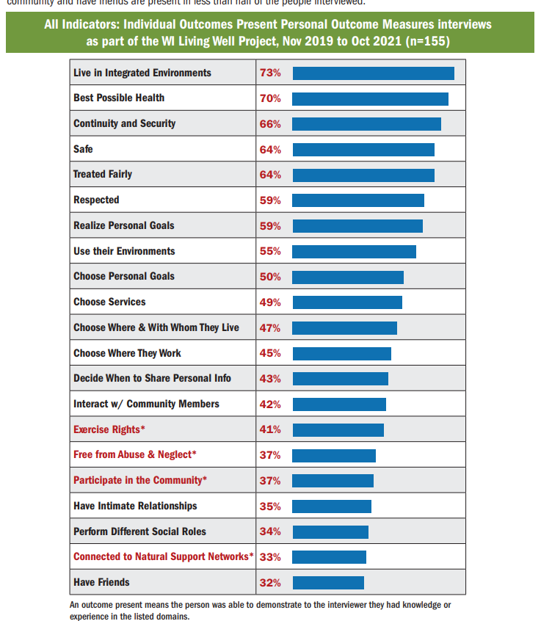
Wisconsin Personal Outcome Measures Interview
Notes:
Sally

Slide 11
Living Well Implementation Strategies that Address Social Isolation and Loneliness
Living Well Implementation Strategies to Address
Social Isolation and Loneliness
Notes:
Kaitlin

Slide 12
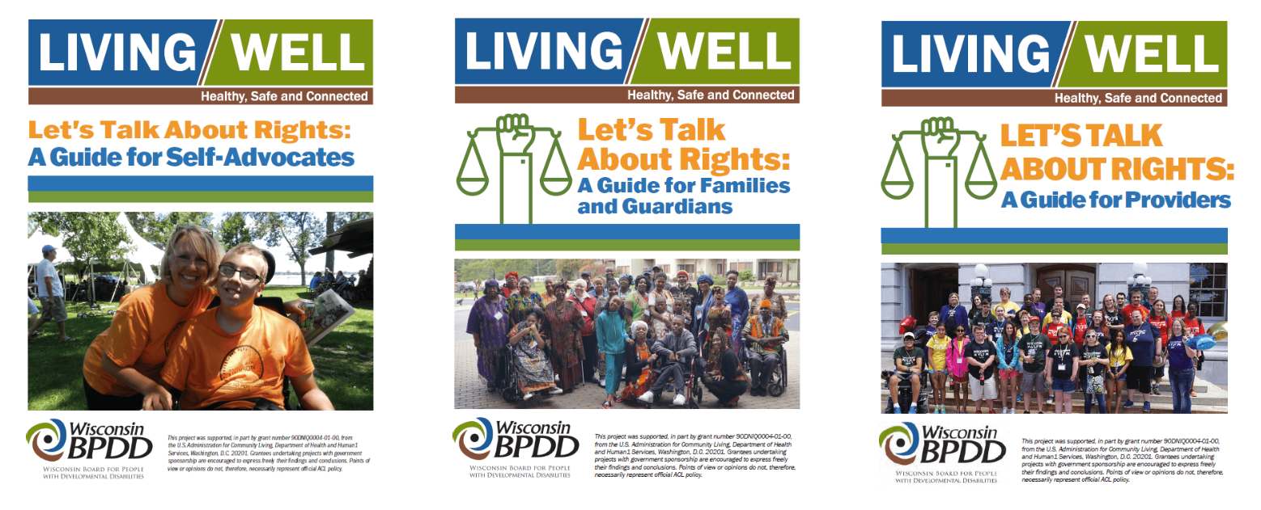
Living Well Implementation Strategies that Address Social Isolation and Loneliness
Living Well Implementation Strategies to Address Social Isolation and Loneliness
Rights Guides
  3 Versions: Self-Advocate, Provider, Family/Guardian
  Address 17 human and choice-making rights that people with disabilities have but don’t often learn about or exercise fully
  Examples: Make your Own Schedule, Talk to and Be Around the People You Want, Live Where and With Who You Want
  Link: https://wi-bpdd.org/index.php/2022/09/09/living-well-rights-guides/
Notes:
Kaitlin

Slide 13
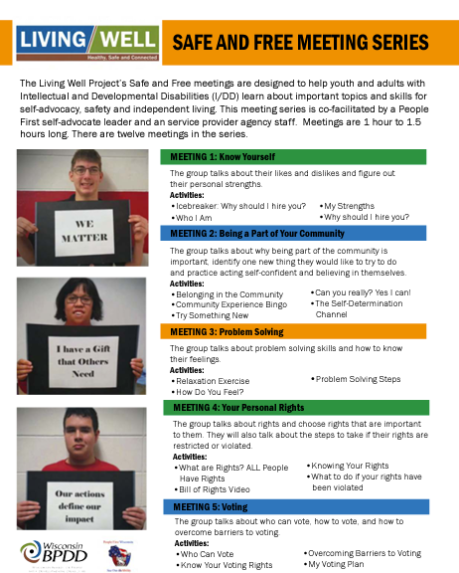
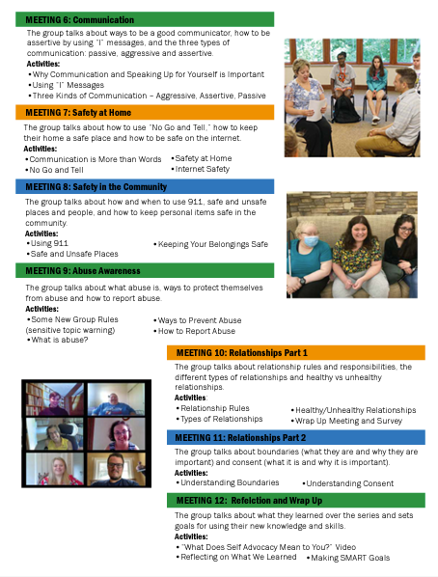
Living Well Implementation Strategies that Address Social Isolation and Loneliness
Living Well Implementation Strategies to Address Social Isolation and Loneliness
Safe and Free
  12 sessions on self-advocacy topics
  Co-lead by a Self-Advocate Leader
  Activities and Conversation Starters give people with disabilities the opportunity to talk about shared lived experiences and goals for taking action in the future
  Link: https://wi-bpdd.org/wp-content/uploads/2022/07/Safe-and-Free-Overview_Rev072022.pdf
Notes:
Kaitlin

Slide 14
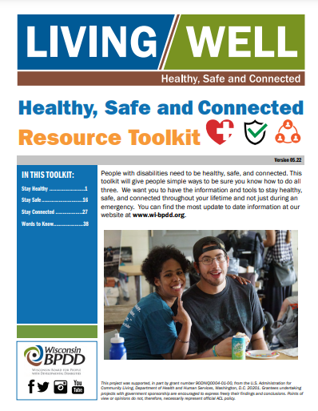
Living Well Healthy, Safe and Connected Toolkit
Healthy_Safe_Connected_V08.22.pdf (wi-bpdd.org)
Notes:
Kaitlin

Slide 15
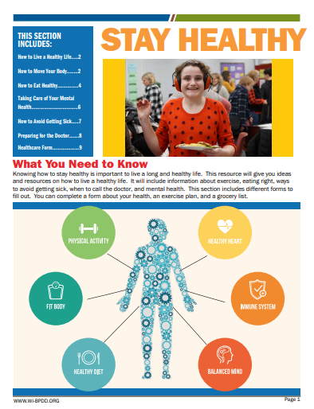
Stay Healthy
Notes:
Kaitlin

Slide 16
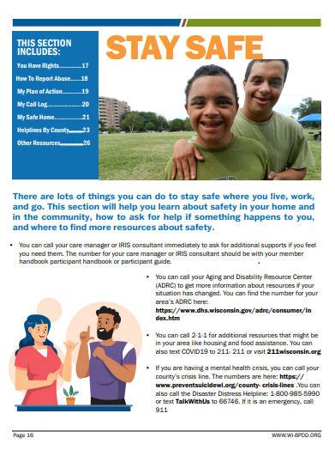
Stay Safe
Notes:
Kaitlin

Slide 17
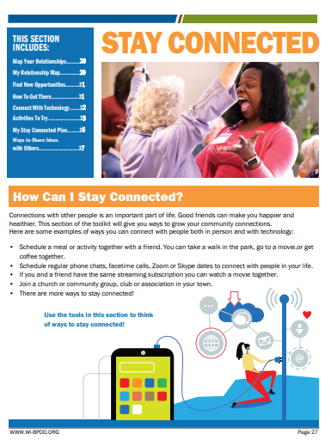
Stay Connected
Notes:
Kaitlin

Slide 18
Stay Connected
Map your relationships
Make a list of ideas
Find new opportunities
How to get there
Connect with technology
Learn how to stay safe online
My Stay Connected Plan
Notes:
Kaitlin

Slide 19
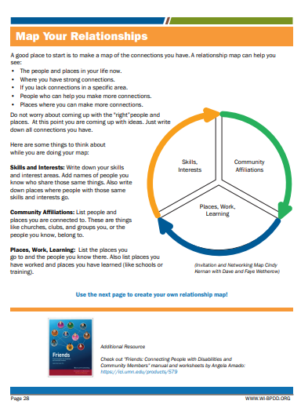
Map Your
Relationships
Notes:
Kaitlin

Slide 20
Map Your
Relationships
Skills and Interests
Community Connections
Places you Go, Work or Learn
Notes:
Kaitlin

Slide 21
Connect with Technology- Be Safe
The internet is a great way to stay connected.
Includes teaching ways to stay safe when using the internet to connect.
Notes:
Kaitlin

Slide 22
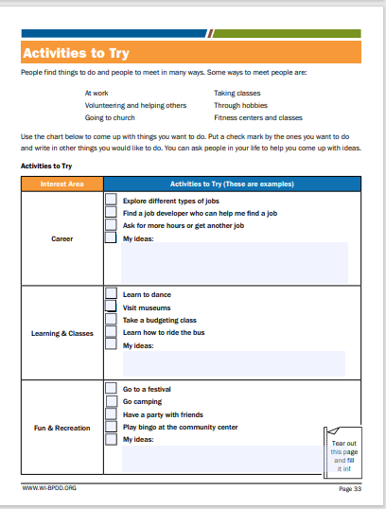
Activities to Try
Notes:
Kaitlin

Slide 23
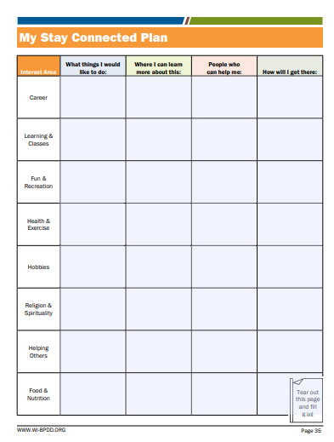
My Stay Connected Plan
Notes:
Kaitlin

Slide 24
BPDD Living Well Project Staff
Sally Flaschberger
Living Well Project Manager
Sally.Flaschberger@wisconsin.gov
608-266-5038
Kaitlin McNamara
Living Well Project Coordinator
Kaitlin.McNamara@wisconsin.gov
608-266-5565

