Slide 1
Rethinking
Guardianship

Slide 2
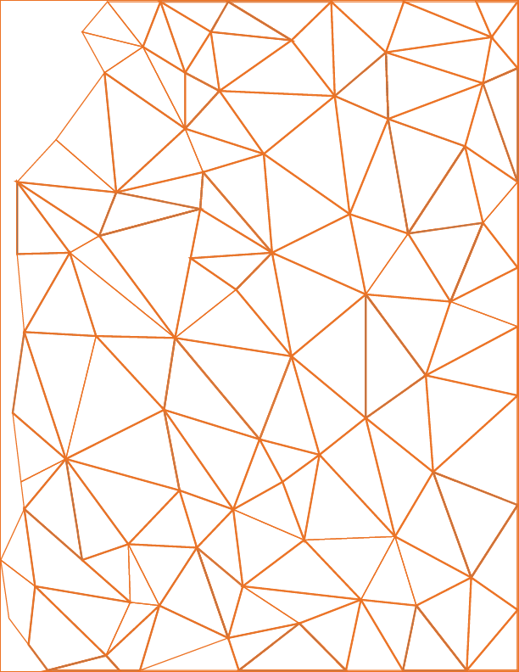
What emotions lead to seeking Guardianship?
LOVE
FEAR
CONCERN

Slide 3
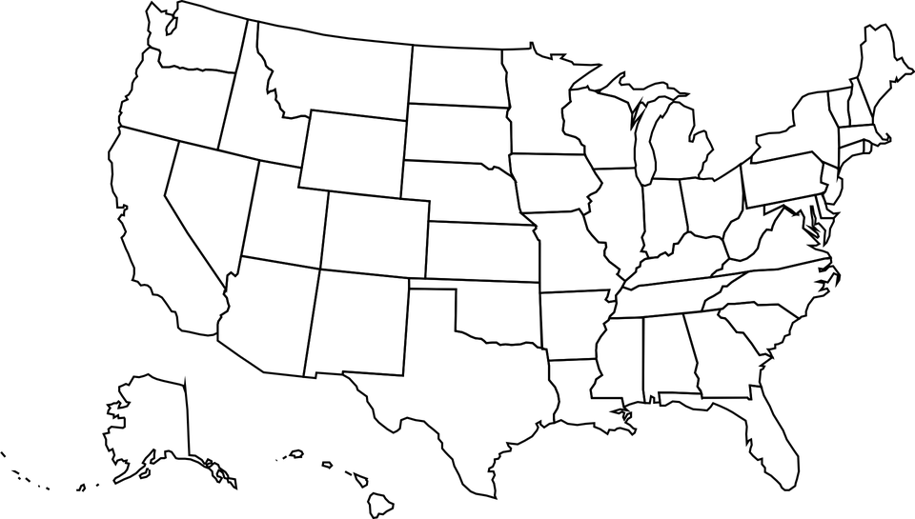
National Core Indicators (2017-18)
Guardianship levels for adults with an I/DD:
Wisconsin: 62% have a guardian
Michigan: 77% have a guardian
I/DD Guardianship laws vary drastically by State.
Nationally: 43% have a guardian

Slide 4
Guardianship is a situation, recognized by law, under which one person or entity exercises power over and on behalf of another person.
(“a ward”)
Who is Self-Determined?
Why be Self-Determined?
Who makes choices about their own life?

Slide 5
Avoid public declaration of incompetency
No independence, dignity, freedom of choice
Why avoid Guardianship?
People deal with guardian – not person
Expense – attorneys, hearings, evaluations
Courts do not always follow law (partial vs. plenary, promote independence, etc.)
It simply does not do what one wants it to do!
Very difficult to modify or terminate
Attorneys and G.A.L.s – very little training
Corporate guardian problems- take money and independence

Slide 6
The vast majority of those who end up petitioning the court to appoint a guardian for some person are either related to the person or a friend.
However, most petitioners do not come to the decision to seek guardianship on their own, but are encouraged to do so by someone else.
Is it you?

Slide 7
“We have to reject the very idea of incompetence. We need to replace it with the idea of ‘assisted competence’. This will include a range of supports that will enable individuals with cognitive disabilities to receive assistance in decision–making that will preserve their rights…”
-Thomas Nerney, Director of Center for Self Determination for Persons with Developmental Disabilities
Supported Decision Making

Slide 8
Supported Decision Making

Slide 9
NETWORK
The # 1 thing
Caring and involved family/friends
Community networks/connections
Unpaid Supports

Slide 10
Notes:
According to the National Core Indicators of 2017-18:
22% of people with an I/DD don’t have friends outside of their paid supports or family.
Michigan: 20%
South Carolina: 11%
42% of people with an I/DD want more help to meet or keep in contact with friends.
Michigan: 49%
South Carolina: 29%

Slide 11
“All people are born equally free and independent, and have certain inherent rights; among these are life, liberty and the pursuit of happiness …”

Slide 12
What emotions lead to seeking Guardianship?
LOVE
FEAR
CONCERN
So… what are the emotions that lead to suggesting it?

Slide 13
Leah Ortiz, LMSW-Clinical
Executive Director
leah@thearccalhoun.org
269.966.2575
Sources: The Arc Michigan, WDHS, NCI
Materials should not be replicated without the permission of The Arc of Calhoun County

