Slide 1
Rethinking
Guardianship

Slide 2
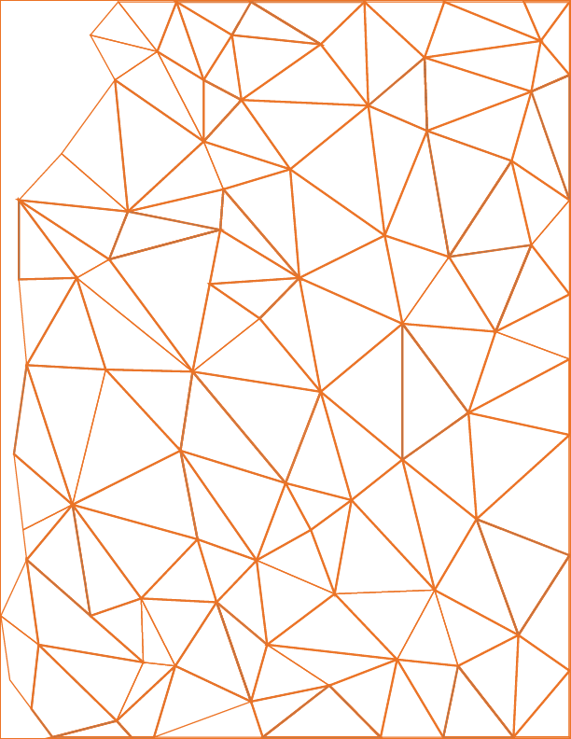
What emotions lead to seeking Guardianship?
LOVE
FEAR
CONCERN

Slide 3
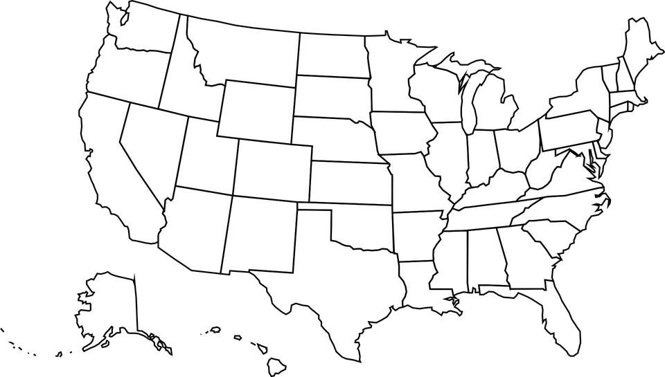
National Core Indicators (2017-18)
Guardianship levels for adults with an I/DD:
Wisconsin: 62% have a guardian
Michigan: 77% have a guardian
I/DD Guardianship laws vary drastically by State.
Nationally: 43% have a guardian

Slide 4
Every person can make choices and has a right to make decisions. People who have a cognitive or intellectual disability may express those choices/decisions in non-traditional ways. Any legal system or proceeding, which deprives an individual of her/his right to be accommodated and supported in choosing and making decisions and which appoints a substitute decision-maker based on tests of competence, makes that person vulnerable and deprives him/her not only of his/her right to self-determination, but also of other rights, which should be inalienable.
Guardianship is a situation, recognized by law, under which one person or entity exercises power over and on behalf of another person.
(“a ward”)
Guardianship

Slide 5
Avoid public declaration of incompetency
No independence, dignity, freedom of choice
Why avoid Guardianship?
People deal with guardian – not person
Expense – attorneys, hearings, evaluations
Courts do not always follow law (partial vs. plenary, promote independence, etc.)
It simply does not do what one wants it to do!
Very difficult to modify or terminate
Attorneys and G.A.L.s – very little training
Corporate guardian problems- take money and independence

Slide 6
The vast majority of those who end up petitioning the court to appoint a guardian for some person are either related to the person or a friend.
However, most petitioners do not come to the decision to seek guardianship on their own, but are encouraged to do so by someone else.
Guardianship

Slide 7
“We have to reject the very idea of incompetence. We need to replace it with the idea of ‘assisted competence’. This will include a range of supports that will enable individuals with cognitive disabilities to receive assistance in decision–making that will preserve their rights…”
-Thomas Nerney, Director of Center for Self Determination for Persons with Developmental Disabilities
Guardianship

Slide 8
Must recognize incongruity of removing a person’s rights to protect them
Guardianship

Slide 9
NETWORK
The # 1 thing
Caring and involved family/friends
Community networks/connections
Unpaid Supports

Slide 10
Notes:
According to the National Core Indicators of 2017-18:
22% of people with an I/DD don’t have friends outside of their paid supports or family.
Michigan: 20%
South Carolina: 11%
42% of people with an I/DD want more help to meet or keep in contact with friends.
Michigan: 49%
South Carolina: 29%

Slide 11
RELEASE OF INFORMATION
The LEAST Intrusive Alternative
Be connected and present
Go to meetings/planning sessions

Slide 12
Person Centered Planning
“Person-centered planning’ means a process for planning and supporting the individual receiving services that builds upon the individual’s capacity to engage in activities that promote community life and that honors the individual’s preferences, choices and abilities. The person-centered planning process involves families, friends, and professionals as the individual desires or requires” MCL 330.1700 (g)
-Michigan’s Long Term Care Group Report and Recommendation,
June 2000
Person Centered Planning

Slide 13
Person Directed
Capacity Building
Person Centered
KEY POINTS:
Network Building
Outcome Based
Community Accountability

Slide 14
What time do they leave for the days activities?
What do they do when they get up in the morning?
Rituals and Routines
To understand a person’s rituals and routines, record what the Monday through Friday schedule looks like (without being intrusive)
What do they eat for breakfast?
How do they get ready for the day?
What does the individual do when they arrive at school, program, work, etc.?
What does the person do when they get home in the evening?

Slide 15
What things make a good day versus a bad day?
Rituals and Routines
You should also record what the person does on the weekends, because weekend activities are usually very different from those of the weekdays.
Next, look over all that very detailed, specific information. Hopefully, you will have learned some general things about this person.
What activities make that person happy?
What activities make them sad or frustrated?
What people or individuals do they enjoy spending time with?
What are events or situations that make them angry or sad?
What features of their environment are pleasant or stressful for the person?

Slide 16
A person-centered plan is meant to empower each individual to communicate what they want in life and to make decisions about the supports desired and needed to achieve their priorities and goals.
When people are supported “one person at a time,” each individual is able to create their own life. The person-centered team or circle of support team assures that all needed supports are available.
The power and decision-making rests with the person with the support of his or her own team.
Empowered Individuals

Slide 17
Power of Attorney
Patient Advocate Designation
Other alternatives to guardianship:
Representative Payee
KEY POINTS:
Financial Supports
Home Supports
Community Supports

Slide 18
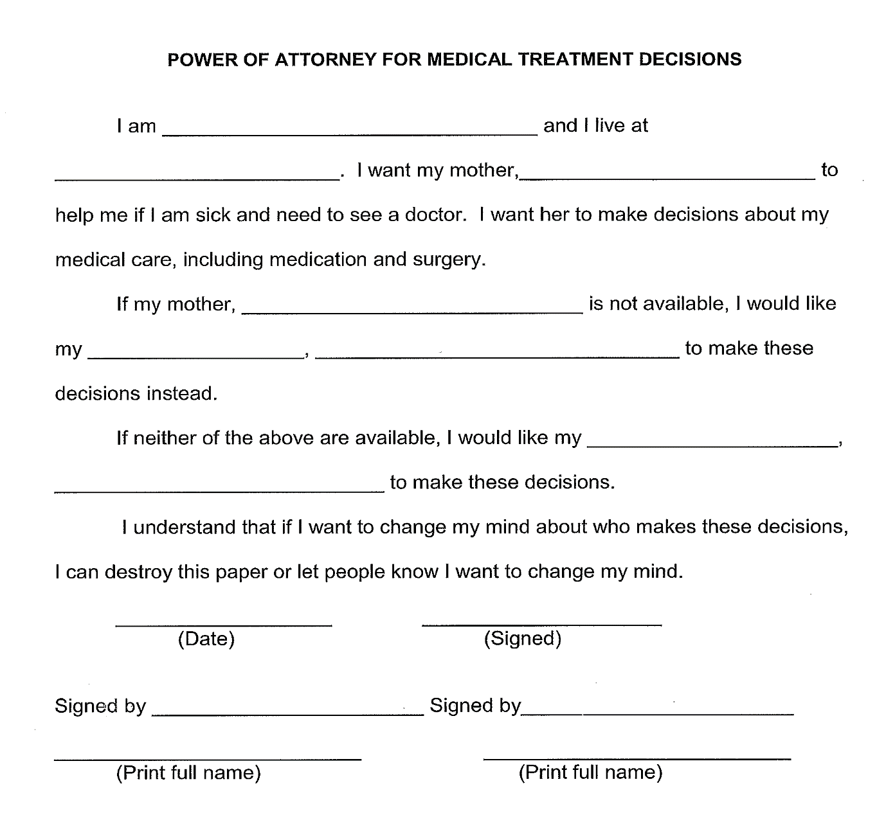
Power of Attorney
Appoint an Agent to handle certain decisions or support with making decisions
Can be effective immediately
Can be as broad or narrow as desired

Slide 19
Exercisable only in event the person is unable to make their own medical decisions (certified by two physicians)
Can be an individual 18 or over to exercise powers related to care, custody and medical treatment decisions of the person.
Patient Advocate Designations (PADs) for Medical Decisions
KEY POINTS:
Includes the individual’s preferences regarding care and treatment.
Necessary for withdrawal of life-sustaining treatment.
Michigan law also permits PADs for mental health decisions.

Slide 20
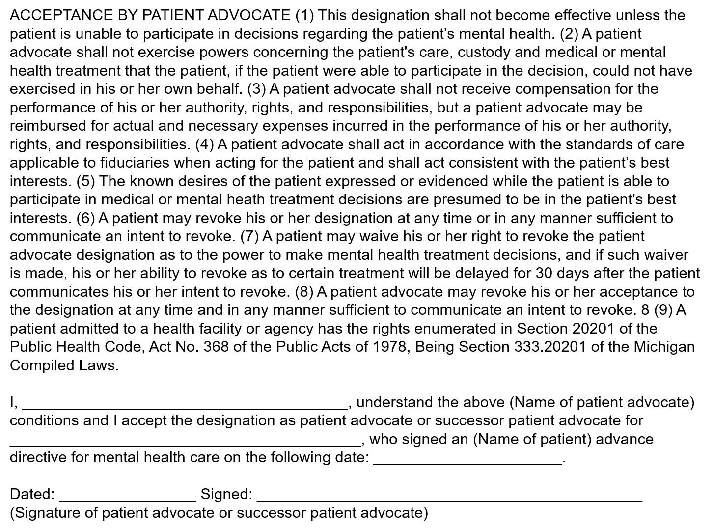
EXAMPLE

Slide 21
Representative Payee
A person or organization designated through the Social Security Administration to handle a person’s Social Security check
SSA has special paperwork and procedures for appointing a representative payee
Can be changed or revoked only if SSA consents.

Slide 22
Withdrawal Limit
Let’s talk about
Credit Card Opt-Out
Banking Services
Financial
Supports
Specific gift cards
KEY POINTS:
Ceiling limit amount
Co-Signer
Personal Money Manager
Fiscal Intermediary

Slide 23
Meal delivery
Let’s talk about
Nutrition, diet, or mealtime support
Service animals
Home Supports
Assistive technology/equipment
KEY POINTS:
Group homes/Roommates
Home visitors
Postal/Utility/Phone checks
Medication assistance
Home health services

Slide 24
Transportation assistance
Let’s talk about
Service animals
Employment/Volunteerism
KEY POINTS:
Community Supports
Religious/Spiritual
Assistive technology
Case management
Supports coordination

Slide 25
What emotions lead to seeking Guardianship?
LOVE
FEAR
CONCERN

Slide 27
Leah Ortiz, LMSW-Clinical
Executive Director
leah@thearccalhoun.org
269.966.2575
Sources: The Arc Michigan, MDHHS, WDHHS, MPF
Materials should not be replicated without the permission of The Arc of Calhoun County

Slide 28
Who in WI can use Supported Decision-Making agreements?
People who can use Supported Decision-Making agreements are defined within Wisconsin’s law as people with “functional impairments” and include:
People of any age with degenerative diseases
People of any age with conditions that substantially interfere with the ability to provide self care
People with physical disabilities or conditions that substantially limits one or more of their major life activities
People with Intellectual/Developmental Disabilities
People with mental health conditions
Notes:
Wisconsin’s law restricts the use of Supported Decision Making agreements to “a person with a functional impairment”
The statutory definition of a “Person with a functional impairment includes”
People with physical, developmental, or mental conditions that substantially limit one or more of an individual’s 1) Capacity for independent living, 2) Self direction, 3) Self care, 4) Mobility, 5) Communication, 6) Learning. (also referred to as major life activities)
People experiencing degenerative diseases or other like incapacities.
Conditions incurred at any age that substantially interfere with the Person’s ability to provide self-care.
The statute DOES NOT require that the existence of a Functional impairment needs to be determined or “certified” by health care professionals

Slide 29
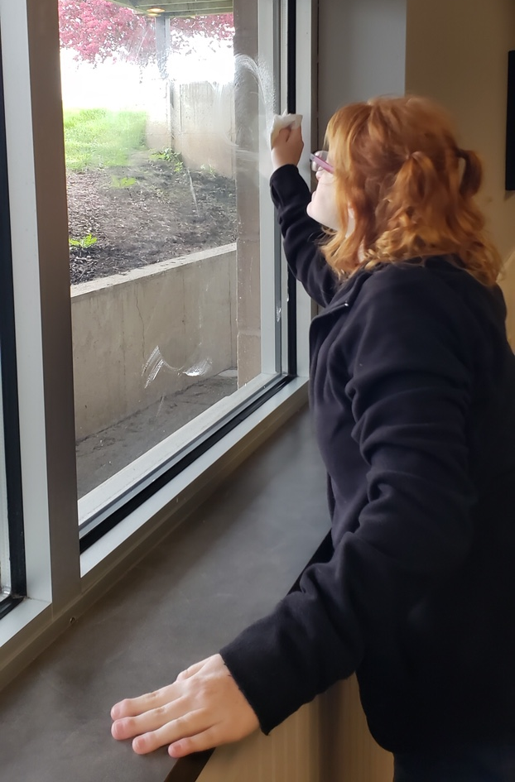
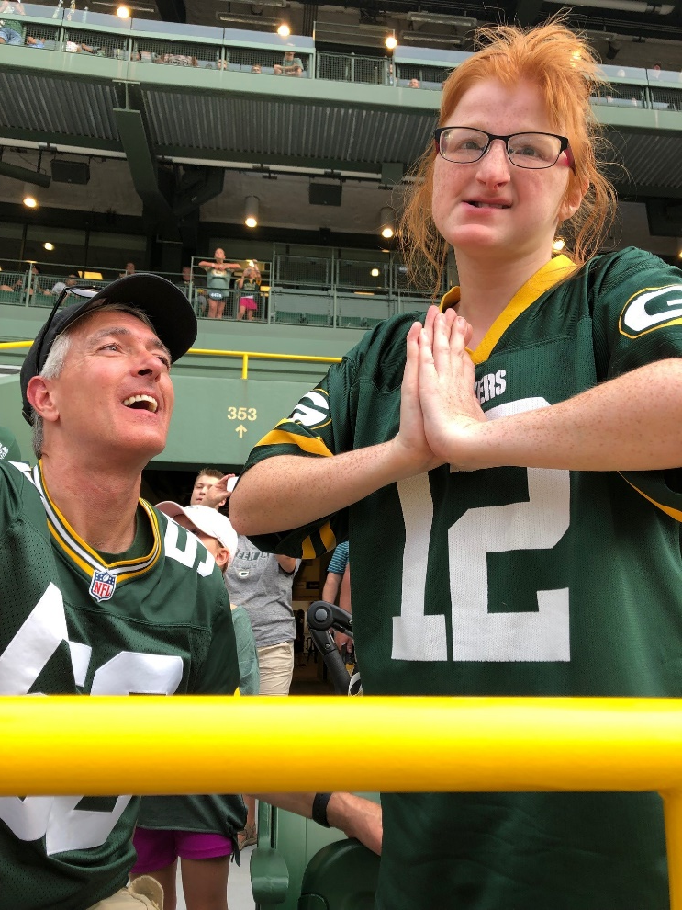
Honoring the Ability to Make Choices

Slide 30
Honoring the Ability to Make Choices

Slide 31
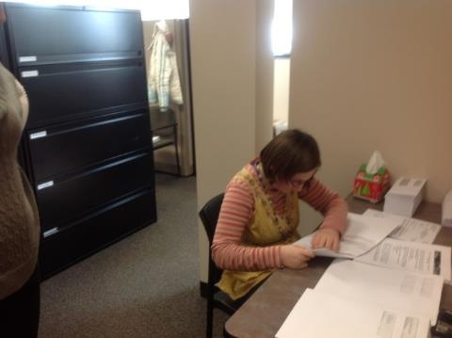
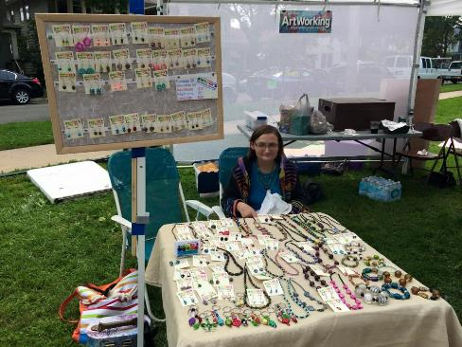
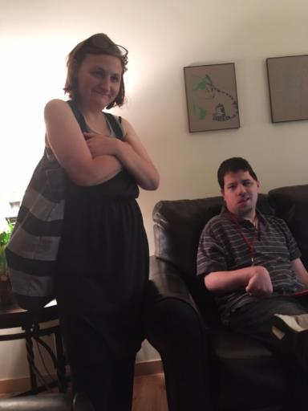
Opportunities for Choice-Making

Slide 32
Opportunities with Implementation in WI?
Many families are interested in using this alternative but find they are pioneers as they interact with medical, financial, and other systems.
Traditional referral sources to guardianship (schools, long-term care programs, courts) have been slow to integrate supported decision-making into their policies and practices.
Wisconsin has a limited guardianship system with defined roles for guardians; often guardians do not act within this role; Guardian training is necessary.

