Slide 1





Nuts and Bolts:
Wisconsin’s Supported Decision-Making Agreement law

Slide 2




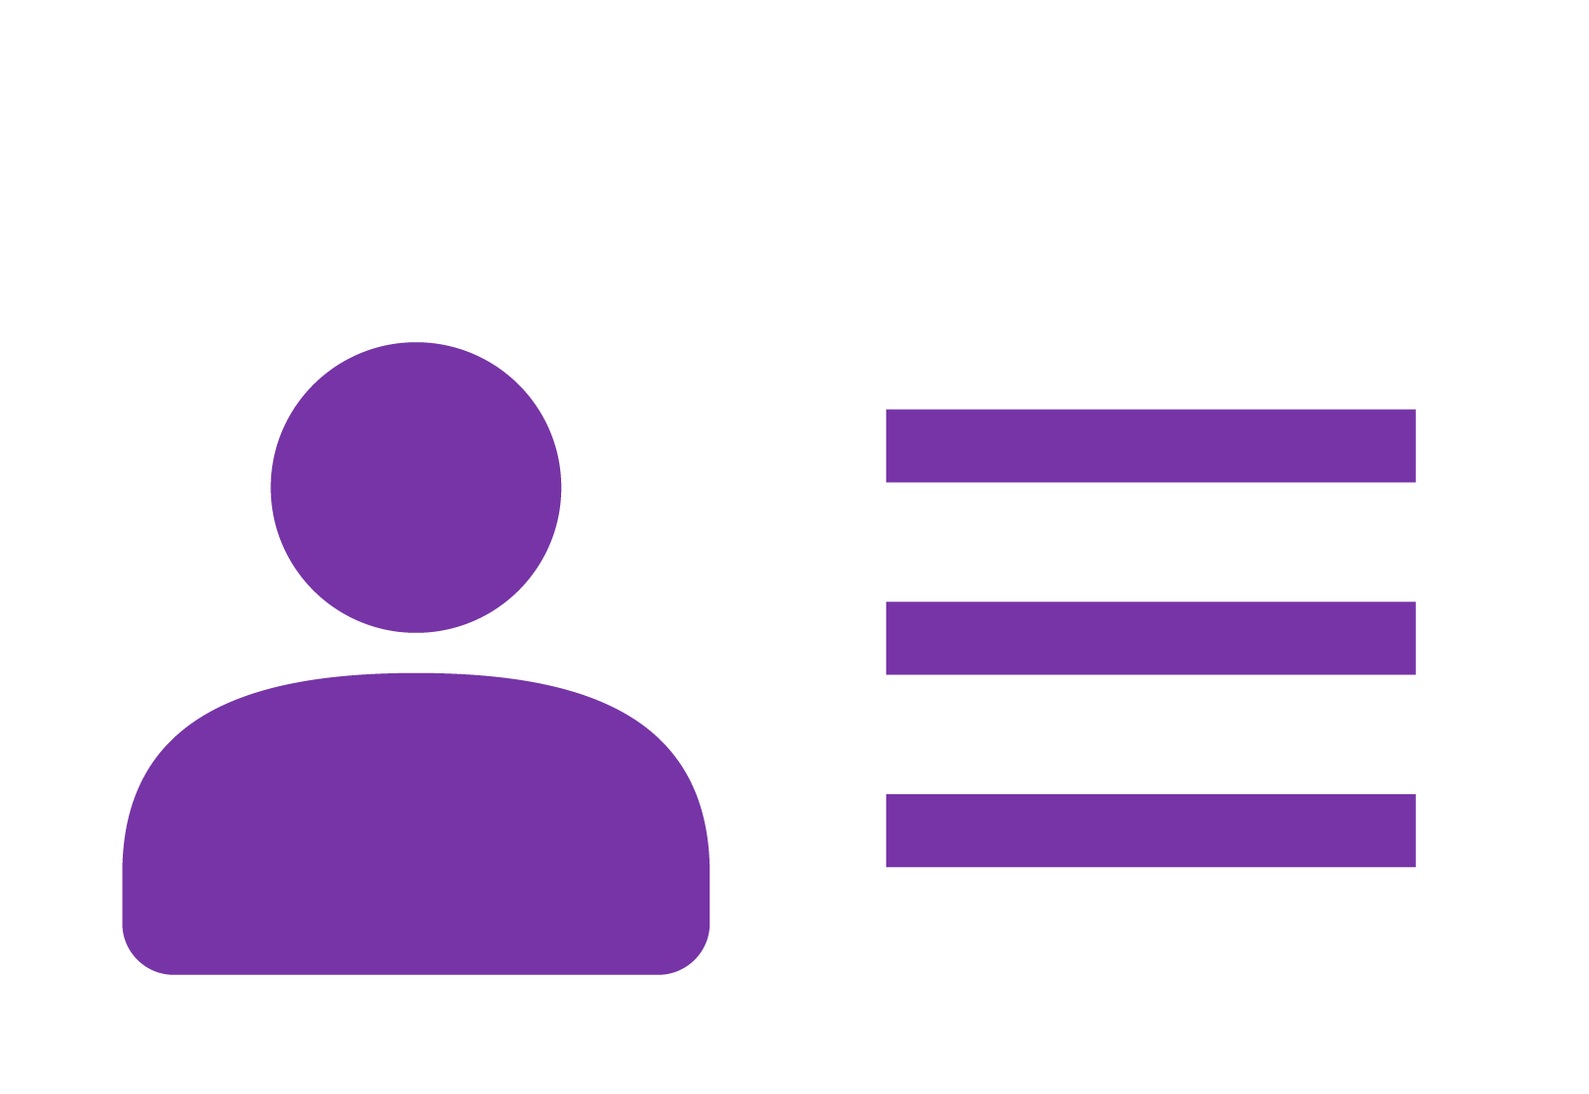
Power of Attorney, medical proxy
Limited or Full Guardianship
Release forms
Supported Decision Making agreements (Wisconsin)
Transfers some or all decision-making authority from the Person to a court-appointed Guardian.
Formal legal arrangements that permit others to act on the Person’s behalf.
Person makes all their own decisions. Person identifies area of the life in which they want support, identifies a Supporter(s) to help them gather information, compare options, and communicate their decisions to others.
Person signs release forms authorizing a specific person(s) access to certain kinds of records (health, financial, etc.).
Some release forms may allow a person to select certain records to be released while retaining privacy over others.
The Supported Decision-Making agreement outlines what types of decisions the Person wants support and the role of the Supporter.
Agreement can be changed or stopped at any time by the Person or Supporter.
Representative payee
The Social Security Administration (SSA) appoints an individual/organization to receive SSI/SSDI benefits for a person who cannot manage or direct the management of their own benefits.
To change a Representative Payee, the Person must complete an application process with the SSA.
Medical Proxy documents appoint a proxy/agent to express a person’s wishes and make health care decisions for the person if the person cannot speak for themselves.
Powers of Attorney (POA) designate another (a POA) individual to make certain decisions (generally health care or financial) on the Person’s behalf. POAs can be set up in different ways. Some POAs are activated only when a person is incapacitated. Or a POA can be written so an individual other that the Person is always the designated decision maker in certain areas.
Once guardianship is granted by the courts it is difficult (and costly) to modify or reverse the guardianship; any changes must be made through a formal court process.
Some release forms may provide one-time or time-limited access to records, others releases may remain in effect in perpetuity.
Current formal tools for people who need help with decisions
Less Limiting
More Limiting
Notes:
There are many options for individuals that want or need help with some or many decisions, and not all of them involve transferring their decision making authority to someone else. Release forms require the person to grant formal permission in order for another individual to see records, but the person doesn’t lose their civil rights to make their own decisions. Supported Decision Making Agreements allow the person to identify the kind of decisions they want support with, a Supporter(s), and to define the role of the Supporter without giving up any of their decision-making authority.
Representative Payees and Powers of Attorneys (POA) do grant decision making authority to another person in certain circumstances but have a much narrower scope of authority than limited or full guardianship. Limited guardianship transfers the authority to make some decisions to another person (guardian), however the ward retains their autonomy and authority to make their own decisions in areas
Supported Decision-Making—both the concept and formal SDM agreements--can be used in combination with other legal arrangements (including Power of Attorney, limited or full guardianship). These options are not mutually exclusive and can be used to complement each other. For many people Supported Decision-Making may be the only tool they need to have trusted people provide support as they make their life decisions.

Slide 3
What is Wisconsin’s law designed to do?
Supported Decision-Making agreements are designed to help the Person interact and communicate their decisions with third parties.
Supported Decision Making agreements allow a person to formally identify Supporter(s) to help them gather information, understand and evaluate options, and communicate their decisions to others.
The Supported Decision-Making agreement lets teachers doctors, bankers, and other professionals know that the Person has given the Supporter consent to hear, receive, and discuss information with them, and/or it is ok to release records to the Supporter (provided applicable releases are signed).

Slide 4
Who in Wisconsin can use Supported Decision-Making agreements?
While all of us use Supported Decision-Making as strategy in our daily lives, only certain people in Wisconsin can use formal Supported Decision-Making agreements.
People who can use Supported Decision-Making agreements are defined within Wisconsin’s law as people with “functional impairments” and include:
  People of any age with degenerative diseases
  People of any age with conditions that substantially interfere with the ability to provide self care
  People with physical disabilities or conditions that substantially limits one or more of their major life activities
  People with Intellectual/Developmental Disabilities
  People with mental health conditions
Notes:
Wisconsin’s law restricts the use of Supported Decision Making agreements to “a person with a functional impairment”
The statutory definition of a “Person with a functional impairment includes”
People with physical, developmental, or mental conditions that substantially limit one or more of an individual’s 1) Capacity for independent living, 2) Self direction, 3) Self care, 4) Mobility, 5) Communication, 6) Learning. (also referred to as major life activities)
People experiencing degenerative diseases or other like incapacities.
Conditions incurred at any age that substantially interfere with the Person’s ability to provide self-care.
The statute DOES NOT require that the existence of a Functional impairment needs to be determined or “certified” by health care professionals

Slide 5
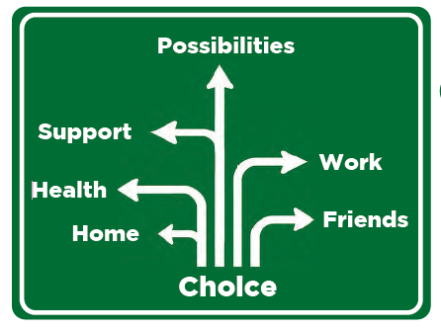
Supported Decision-Making agreements
Agreements can be used for any decisions the Person feels they need additional support—such as housing, health care, financial affairs, employment, etc.
Supported Decision-Making agreements are flexible and can be updated easily as the Person’s ability and capacity to make decisions changes over time.
Notes:
People with Intellectual/Developmental Disabilities (I/DD) continue to gain experience throughout their lives that can increase decision-making skills. SDM agreements can provide support as the person practices making decisions.
Changes in functional impairments (more or less) through a rehabilitation process or progressive conditions can change the kinds of decisions with which a Person wants support.

Slide 6
What Supported Decision-Making agreements do NOT do.
They do not restrict a Person’s rights to make any decisions.
  Having a supported decision-making agreement does not preclude the Person from acting independently of the agreement or making decisions that the Supporter does not agree with.
  The Person is always in control of their own decisions.
It does not give Supporters any new rights
  The Supporter has no authority to make the person’s decisions. The Person makes all their own decisions.
  Supporters cannot sign legal documents for the Person or bind a Person to a legal agreement
  Supporters have only the authority/role granted by the Person under the terms of the supported decision-making agreement.
Notes:
Completing a Supported Decision Making agreement cannot be used as evidence of incapacity or incompetency of the Person.

Slide 7

What is the role of the Supporter?
The possible roles of the Supporter are limited to:
  Access, collect, or obtain information relevant to a decision area the Person has chosen
  Helping the person understand that information;
  Helping the Person understand their options, responsibilities, and consequences of that person's life decisions, without making those decisions on behalf of that person
  Assisting with communicating the Person’s decision to others
Notes:
Note: A Supporter is allowed to access records that require a release only if the Person has signed a release allowing the Supporter to see the information

Slide 8

What is the role of the Supporter
The law limits access to personal information. Only information that is relevant to the decision with which a Supporter has been asked to assist is accessible by the Supporter.
  Note: A Supporter is allowed to access records that require a release only if the Person has signed a release allowing the Supporter to see the information
Supporters are required to ensure all personal information they access in the course of fulfilling a Supported Decision-Making agreement is kept privileged and confidential and is not subject to unauthorized access, use, or disclosure.

Slide 9
Using Supported Decision Making Agreements

Slide 10
What is included in a supported decision-making agreement?
The law includes standard elements that must be included in all Supported Decision-Making agreements.
  The name and contact information of the Supporter(s)
  Type(s) of decisions the Person wants Support with;
  The role(s) the Person elects to allow the Supporter to do
  The effective date of the agreement and any end date the Person chooses to specify
  The signatures of the Supporter(s), two witnesses or a notary public

Slide 11
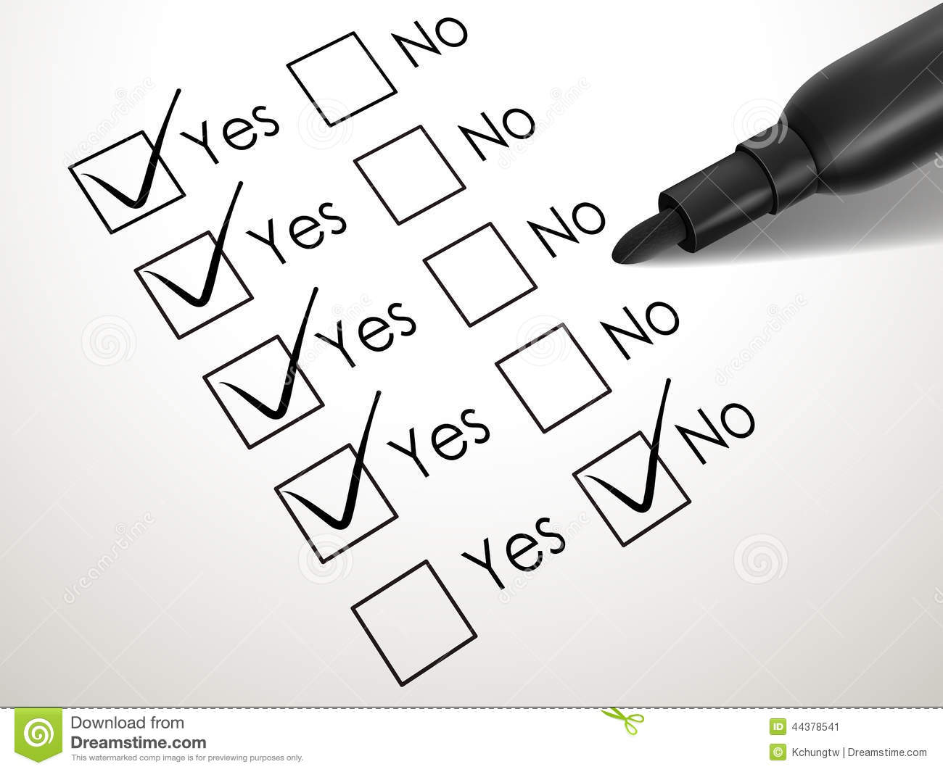
What is included in a supported decision-making agreement?
Types of decisions included on the form:
  Obtaining food, clothing, and shelter
  Taking care of my physical health
  Managing my financial affairs
  Taking care of my mental health
  Applying for public benefits
  Assistance with seeking vocational rehabilitation services and other vocational supports
  other decisions I have specifically identified that I would like assistance with

Slide 12
What is included in a supported decision-making agreement?
Check either Yes or No to give permission for a Supporter to help
You can also list other kinds of decisions not on the form that you want a Supporter to help with
The law presumes if you do not check Yes or No (i.e. leave both options unchecked) that you do not want the Supporter to help with that kind of decision.

Slide 13
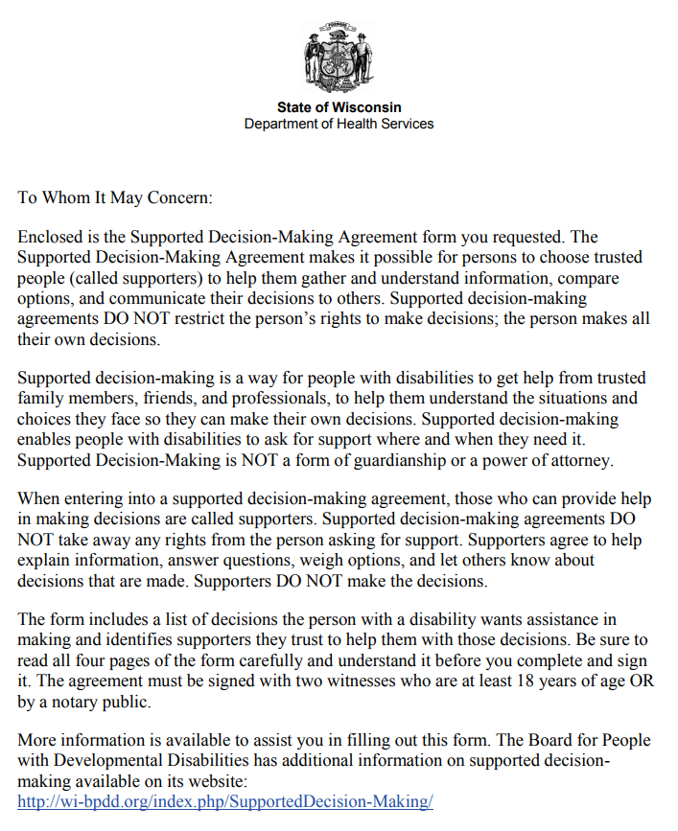
Official Wisconsin Supported Decision-Making Agreement form
https://www.dhs.wisconsin.gov/forms/f02377.pdf

Slide 14
More features of Wisconsin’s law

Slide 15
How are Supported Decision-Making agreements changed or terminated?
The Person is always in control of their own decisions and their Supported Decision-Making agreement.
The Person can include a specific date when the agreement ends.
Either the Person or the Supporter can revoke a Supported Decision-Making agreement at any time.
Agreements are automatically revoked if the Supporter has a substantiated allegation of neglect or abuse of the person, the Supporter has been found criminally liable for abuse or neglect, or there is a restraining order against the Supporter.
Notes:
Just like Powers of Attorney, limited guardianships, and full guardianships, a patient’s Supported Decision-Making agreement(s) should be noted in their records and kept on file. It is the Person’s responsibility (just like POAs) to make sure that any changes to an existing agreement, revocation of an existing agreement, or additional agreements are kept current in their files.
Just like other legal options (like POAs and guardianship), electronic record management systems may need to be adjusted to reflect this new option. Ideally, staff should be able to indicate in a patient’s electronic medical record if they have an SDM agreement and provide access to the actual agreement. Since SDM agreements can be used in conjunction with POAs, limited guardianship, and record releases, electronic records management systems should ensure that multiple legal arrangements can be selected in individual records.
SDM agreements are legally recognized, and should be honored. We sometimes get the question of enforcement; POAs and letters of guardianship do not have enforcement provisions within state statute either, but providers do not question whether they need to honor those.
Other states have supported decision making laws too: Texas, Delaware, Tennesse, Wisconsin, Washington DC, Alaska, Indiana. Several other states have passed legislation authorizing study of Supported Decision Making as an alternative to guardianship (Maine, Washington, Virginia, North Carolina).

Slide 16

Can a Person have more than one Supporter or agreement?
A Person may have multiple Supported Decision-Making agreements.
The Person can choose different Supporters for different decision types.
The Person can identify more than one Supporter in the same Supported Decision-Making agreement.

Slide 17

Liability protections for practitioners
Professionals who receive a Supported Decision-Making agreement are required to rely on that agreement as a legal expression of the Person’s wishes.
Liability protections for professionals and Supporters are included for actions done in the context of a valid Supported Decision-Making agreement
Notes:
Wisconsin Statutes Ch 52.30 details the liability protections.
A person who receives the original or a copy of a supported decision-making agreement shall rely on the agreement, except if the person has cause to believe that the adult with a functional impairment is being abused, neglected, unduly influenced, or financially exploited by the supporter as described under s. 52.32.
A person is not subject to criminal or civil liability and has not engaged in professional misconduct for an act or omission if the act or omission is done in good faith and in reliance on a supported decision-making agreement.
Any health care provider that respects and acts consistently with the authority given to a supporter by a duly executed supported decision-making agreement shall be immune from any action alleging that the agreement was invalid unless the entity, custodian, or organization had actual knowledge or notice that the adult with a functional impairment had revoked such authorization, that the agreement was invalid, or that the supporter had committed abuse, neglect, or financial exploitation as described in s. 52.14 (2) (a).
Any health care provider that provides health care based on the consent of an adult with a functional impairment, made with supports and services provided through a duly executed supported decision-making agreement, shall be immune from any action alleging that the adult with a functional impairment lacked capacity to provide informed consent unless the entity, custodian, or organization had actual knowledge or notice that the adult with a functional impairment had revoked such authorization, that the agreement was invalid, or that the supporter had committed abuse, neglect, or financial exploitation as described in s. 52.14 (2) (a).
Any public or private entity, custodian, or organization that discloses personal information about an adult with a functional impairment to a supporter who is authorized to access, collect, or obtain or assist the adult with a functional impairment in accessing, collecting, or obtaining that information shall be immune from any action alleging that it improperly or unlawfully disclosed such information to the supporter unless the entity, custodian, or organization had actual knowledge that the adult with a functional impairment had revoked such authorization.
The existence or availability of a supported decision-making agreement does not relieve a health care provider of any legal obligation to provide services to individuals with disabilities, including the obligation to provide reasonable accommodations or auxiliary aids and services, including interpretation services and communication supports to individuals with disabilities under the federal Americans with Disabilities Act.

Slide 18
What do I do if I suspect abuse, neglect, or financial exploitation?
Anyone who suspects that a Supporter is abusing, neglecting, or financially exploiting a person with a functional impairment may report their concerns to the elder or adult at risk agency, or appropriate law enforcement agency.
Those who are required by law to report abuse, neglect, or financial exploitation (i.e. mandated reporters) must still follow those requirements.
Notes:
An elder at risk is over 60, an adult at risk is 18-59.

Slide 19
Shift to alternatives to guardianship first
Schools are now required to provide students and parents with information on supported decision-making and other alternatives to guardianship.
In guardianship proceedings, before ruling on the guardianship, judges are now required to consider
  Whether any alternatives to guardianship, including Supported Decision -Making, have been tried, and
  Whether less restrictive means, including Supported Decision-Making, could be used.
A supported decision-making agreement may not be used as evidence of incapacity or incompetency of the Person.
Notes:
In guardianship proceedings, before ruling on the guardianship, judges are now required to consider 1) whether any alternatives to guardianship, including SDM, have been tried, and 2) whether less restrictive means, including SDM, could be used.

Slide 20
Supported Decision-Making Resources
Webinars, presentations, information sheets and materials for families: http://www.wi-bpdd.org/SupportedDecision-Making/
Supported Decision Making Agreement form: https://www.dhs.wisconsin.gov/forms/f02377.pdf
Supported Decision Making statute (Wis. Stats. Ch 52, http://docs.legis.wisconsin.gov/statutes/statutes/52)
Notes:
Multi pager on Supported Decision Making
Multi pager on Guardianship Alternatives
Supported Decision Making Agreement worksheet
Supported Decision Making Frequently Asked Questions
Official Supported Decision Making agreement form (DHS)
Supported Decision Making tracking: who are my supporters and where have I shared my agreement
All the documents above are included in our standard “SDM toolkit” that we print out in hard copy and assemble into folders. These are available to ADRCs, providers, etc. if they would find it helpful as they interact with families. They can contact Jeremy Gundlach in our office with publication orders.

Slide 21
Practical Examples
Using Supported Decision-Making agreements

Slide 22
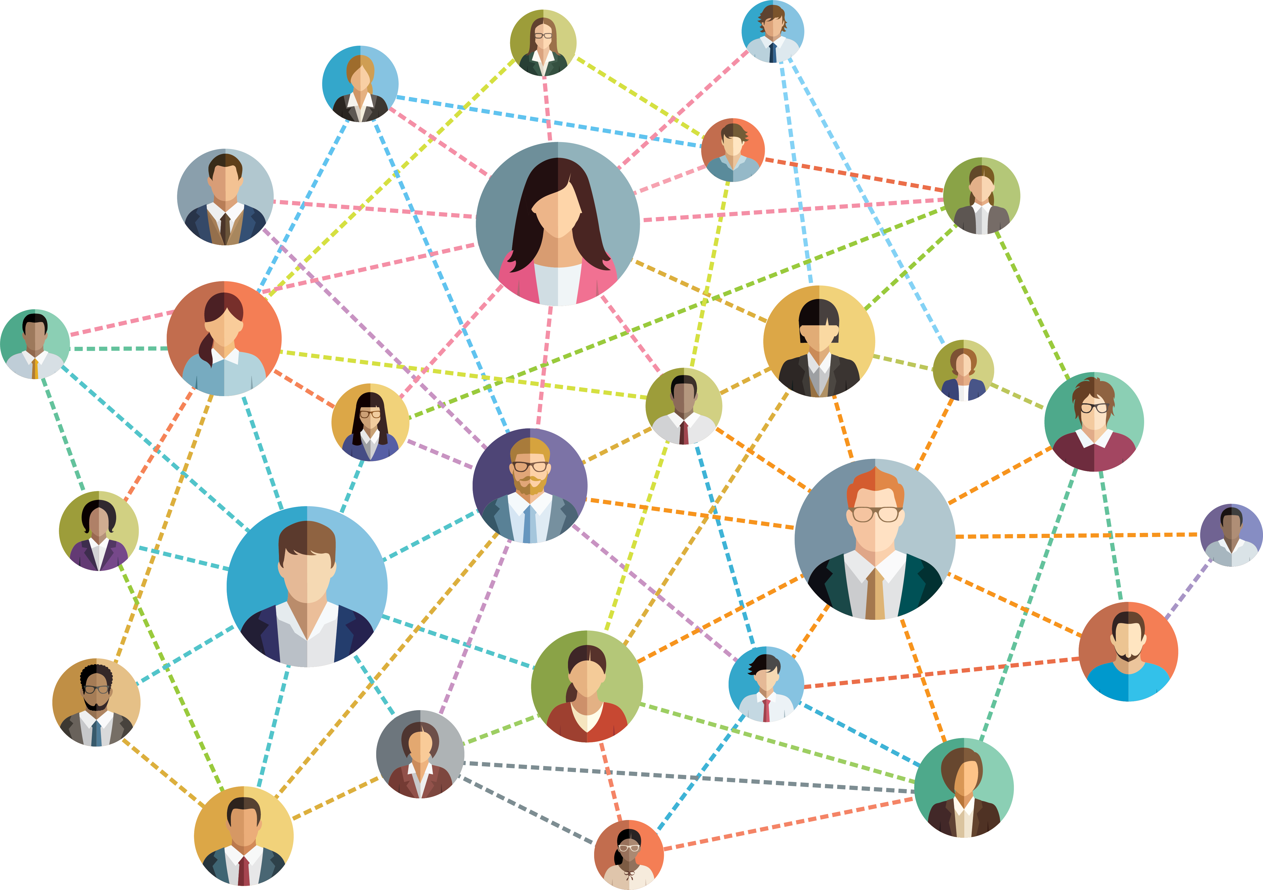
Ensure friends, non-family, or extended family can act as Supporters
  Sometimes the closest relationships are with extended family.
  Family members are not always geographically close, and some people do not have family.
  Many people with functional impairments do have close relationships and social networks with non-family members who want to help.
  Supported Decision-Making agreements ensure that non-family members are recognized as carrying out roles and responsibilities specified by the Person.

Slide 23

Can adjust based on person’s support needs
Can help people experiencing changes in memory and cognition, and other abilities that may decline over a long period of time.
Many people need a little help for a long time.
Allows for a transition to more support when needed.
Notes:
Supported Decision-Making is flexible and can be updated easily as the Person’s ability and capacity to make decisions changes over time, due to gaining of experience and skills or acquiring additional functional impairments.

Slide 24

Can be used for many kinds of decisions
Supported Decision-Making agreements can be used by people who want help with decisions not typically covered by traditional Powers of Attorney like:
  housing/living arrangements,
  choosing a service provider (Examples -internet, cellphone, cleaning service),
  filing taxes etc.

Slide 25
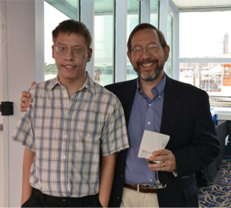
Support in school and with agencies
Students with disabilities can use Supported Decision-Making agreements to allow their parents to continue to participate IEP meetings.
Can be used to ensure Supporters can attend meetings, gather information, and communicate with state agencies/providers/private entities on behalf of the Person.

Slide 26
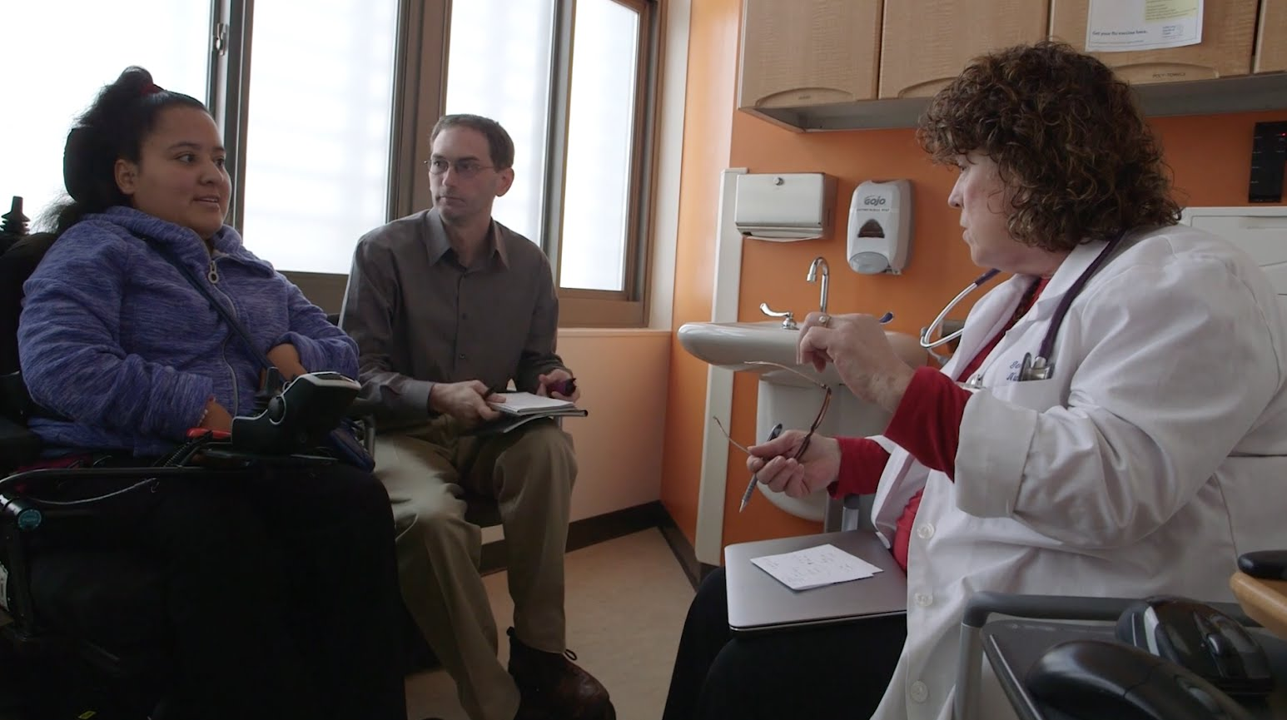
Communication: person to practitioner
Helps ensure the Person is clearly understood by medical or other staff.
People who have challenges with speech, use sign language or communication devices, and/or who are non-verbal communicators might use a Supporter to ensure the other party understands them.
Notes:
BPDD board member has cerebral palsy, which has significantly impacted him physically (does not have use of hands, uses a power chair, needs assistance to eat) and affected his ability to speak (slower speech that can be difficult to understand by people who have not had practice). He has no intellectual disability (he has a master’s degree), but because of his physical disability and speech medical professionals have assumed that he has a guardian. Even when he has explained that he does not have a guardian, health care staff have not believed him. At one point, he had to have medical staff call his mother so they could confirm that he did not have a guardian (and that they could interact with him about his own medical care). He is in his late 30s, and feels strongly that part of being treated as an adult is to not have to rely on his parents to intervene or be present in routine life events, including medical appointments.
SDM agreements can identify a Supporter whose role it is to ensure that the Person’s communication and decisions are clearly understood by medical staff. Supporters who are familiar with the person and their unique communication characteristics can ensure that the provider is not assuming or interpreting speech (or other communication) and misunderstanding the person. This can help medical professionals to gain important information from the patient (description of symptoms, etc.), patient concerns, engagement in treatment options etc.

Slide 27
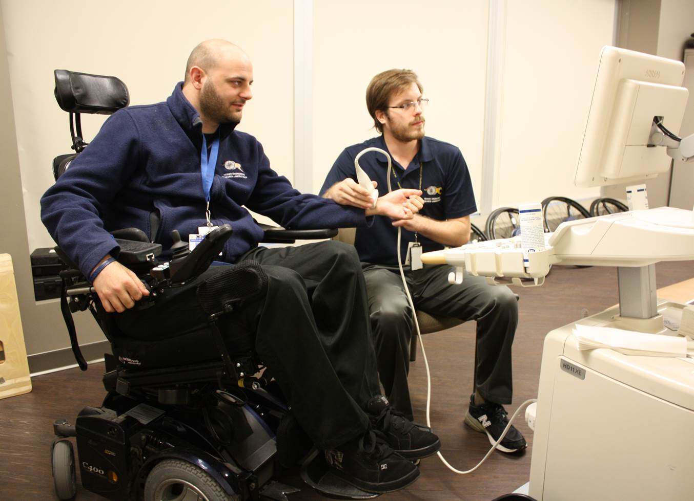
Communication: practitioner to person
Supporters can help people understand information and their options in ways that make sense to them.
A Supporter can help professionals more effectively communicate complex information and understand the person’s questions/concerns.
Person-centered planning and care relies on the person feeling informed and having control over their own decisions.
Notes:
Medical terms can be confusing and appointment times are short.
Patients may be hearing complex terms, information, or options that they need help understanding
Patients may be hearing information that is emotionally distressing or deeply impactful to their lives
Patients may have conditions—illnesses, mental health conditions, side effects from medications, pain, or difference in cognitive processing due to disability—that interferes with comprehension or speed of comprehension
Everyone has a unique set of experiences and ways of relating to the world that influence how they understand and process information. Supporters have knowledge of the person that a practitioner may not have, including communication strategies and past experiences, that may facilitate effective understanding.

Slide 28
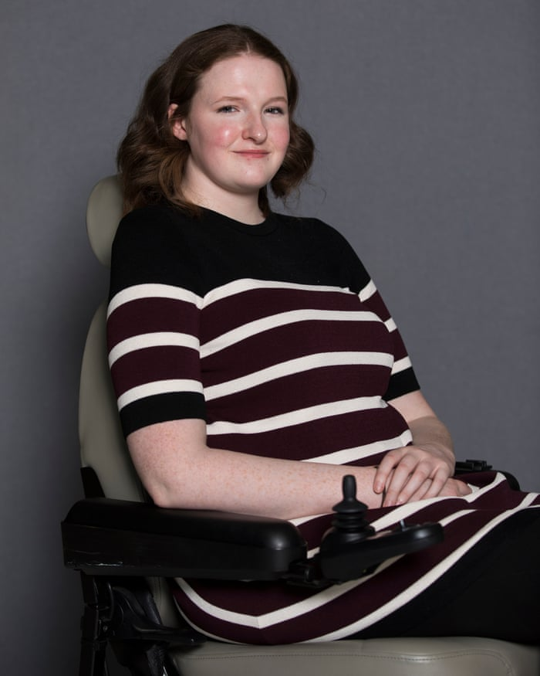
Presumes competency and person centeredness
Supported decision-making embodies the spirit of the law, which presumes competence.
By its nature, it orients us to patient centeredness.
It reminds us that the person makes their decisions, and reinforces the role we all play in providing the best information possible so they can make decisions.
It also recognizes people need support to make their own informed choices.
Notes:
As an example, my co-worker described a recent experience that illustrates the impacts it can have on care when practitioners assume that the presence of a disability means a lack of competence.
My co-worker is in her early forties, and uses a wheelchair. She has spinal bifida, a developmental disability. This does impact her mobility, but not her intelligence (she has a masters, has worked full time her entire life) or her independence. She met with a new primary care physician, who took a look at her wheelchair and the first interaction was to question who her guardian was. In other words, the first impression the new patient has is that her medical professional has assumed based on her physical disability that this patient cannot be who is deciding about their care (i.e. who is the person I need to talk with who makes decisions about you). The doctor also assumed, based on disability, that my co-worker was not married (she is) and she did not have children (she has two), because of the presence of disability. Set aside the impact these assumptions have on the doctor-patient relationship, and focus on what these assumptions may mean for patient health care (reproductive health care, conditions that are unrelated to the underlying disability etc.).

Slide 29
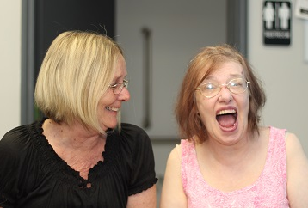
Presumes competency and person centeredness
Useful tool to examine assumptions based on disability that may be embedded in the institution’s practices or their staff responses to patients.
Many people with disabilities describe staff discomfort interacting with people with disabilities, assumptions of guardianship, lack of accessibility and accommodations etc.
Notes:
Another example, a parent friend of mine recently described an experience with her daughter who has a disability and is transitioning to adulthood. Her daughter has I/DD, autism and a co-occurring condition that has a variety of health impacts including vision issues and the need for annual eye exams to check for glaucoma. Her daughter is non-verbal, but uses an ipad to communicate; people who know her understand what she is communicating and can explain things to her.
She has had an annual eye exam with a pediatric practitioner for many years who had agreed to continue seeing her after she turned 18, at least until a different provider could be found. Like most specialists, appointments are scheduled well in advance. Her appointment was made when she was 17 and was for several months in the future. They day before the appointment, a nurse called her mother and informed her that her daughter’s appointment had been cancelled. Apparently the nurse had taken it upon herself to look up the patient’s co-occurring condition, decided that the diagnosis meant that wasn’t capable of making any decisions, and since she was over 18 and did not have a guardian that she could have the appointment.
Just focus on the unnecessary stress that the family had to bear to prove to their own health care provider that the rights that all of us are presumed to have also stand for their daughter (the parents literally filmed with an iphone the daughter understanding the explanation of why she needed the appointment, agreeing to the appointment, and using her stamp to grant her parent access to attend the appointment). The practitioner intervened, the daughter was seen, but the example is stark.

Slide 30

Using supported decision making helps young people transition to adulthood
Even when children are under their parent’s guardianship by virtue of age, supported decision making concepts enable:
  Parents to practice involving their child in increasing amounts of decision-making
  Practitioners to establish a one on one relationship with the person
Notes:
Many parents do not understand that a guardian/ward relationship is not the same as parent/child.
As children age their bodies are developing and changing independently of their disability and health conditions. Parents and practitioners should not assume that disability does not mean that children are going through the “normal” emotional, physical, and sexual changes of adolescents; like all young patients children with disabilities need time alone with practitioners to discuss issues that they may not want their parents to hear or be involved in.

Slide 31
Questions?

